Slide 1
1. Placement of Encryption Function End to end, Link to Link, 2. Key Distribution and Management Key distribution using Secret key cryptography, For link encryption, For E2E encryption, Key Management, 3. Diffie-Hellman Key Exchange
Ayesha jarral

Slide 2
E TO E encryption
Definition: Data is encrypted by the sender and decrypted only by the final recipient.
Purpose: Ensures the data remains secure even if it passes through multiple intermediate nodes (e.g., servers or routers).
Steps:
Sender encrypts the data with the recipient's public key.
Data travels through the network but cannot be read by intermediate nodes.
Recipient decrypts the data with their private key.
Example: Messaging apps like WhatsApp use E2E encryption. If someone intercepts the data, it will appear as unreadable ciphertext.

Slide 3
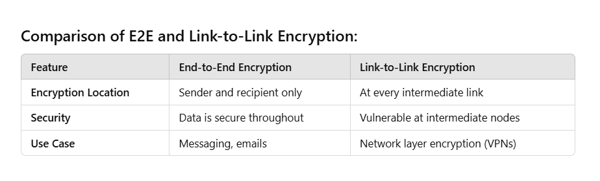
Link-to-Link Encryption
Definition: Each link in the communication path is encrypted and decrypted at every intermediate node.
Purpose: Protects data during transmission over each segment of the network.
Steps:
Sender encrypts the data and sends it to the first node.
The node decrypts it, processes it, and re-encrypts it before forwarding it to the next node.
This process repeats until the data reaches the recipient.
Example: VPNs use link-to-link encryption to secure data between devices and servers.

Slide 4
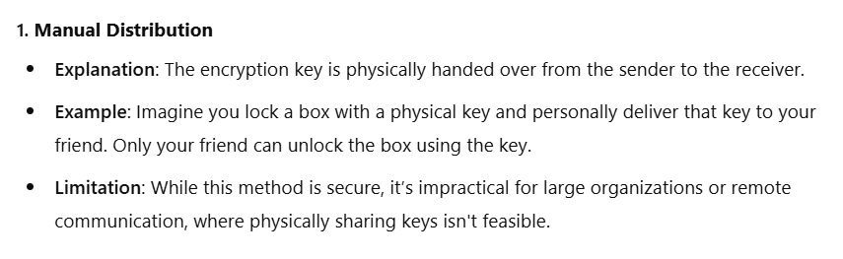
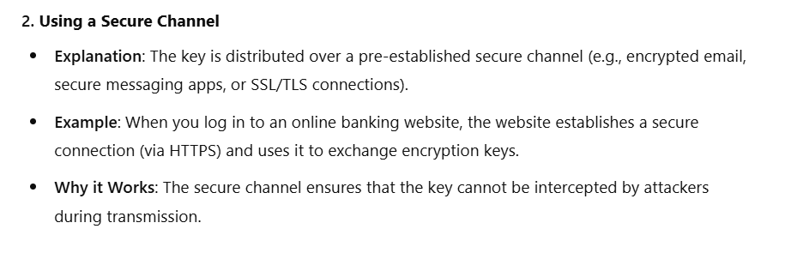
Key Distribution and Management
Keys are essential for encryption and decryption. Managing and distributing these keys securely is critical.

Slide 5
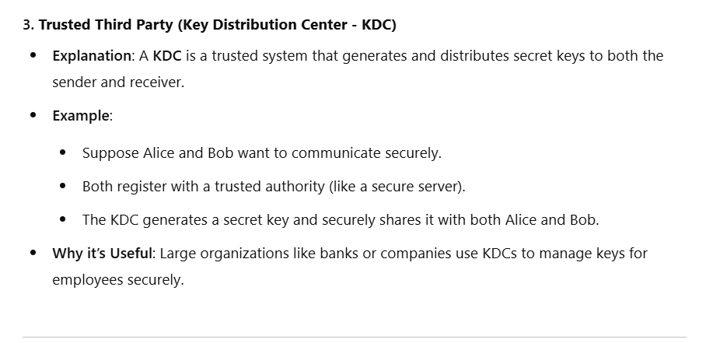
Key Distribution and Management

Slide 6
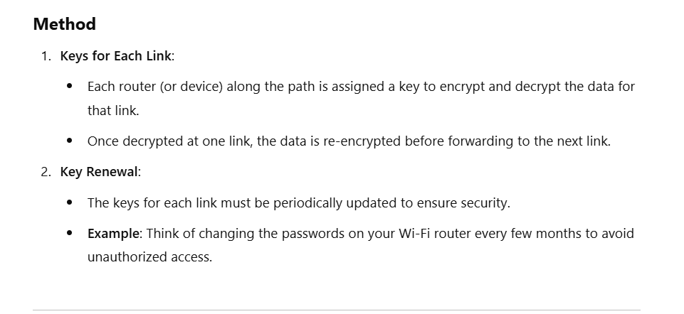
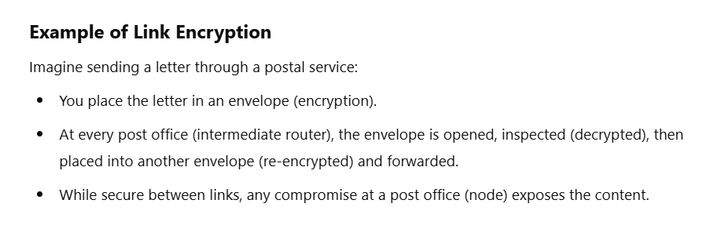
Key distribution for link encryption

Slide 7
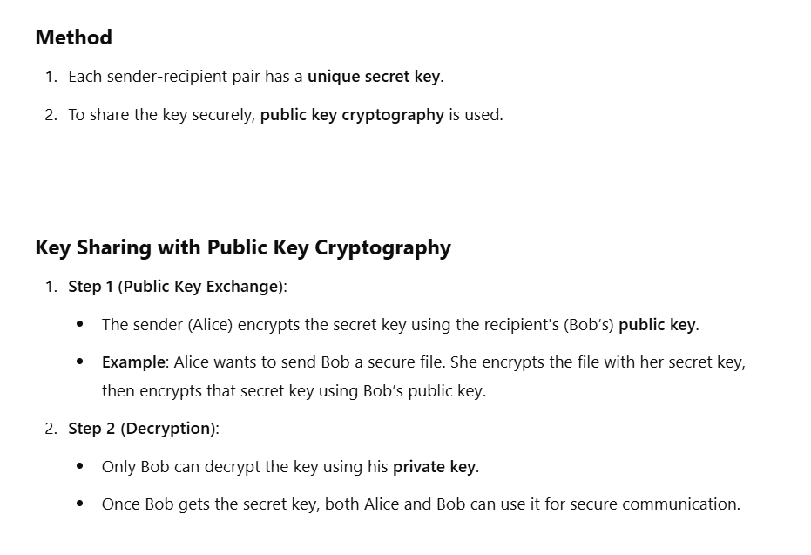
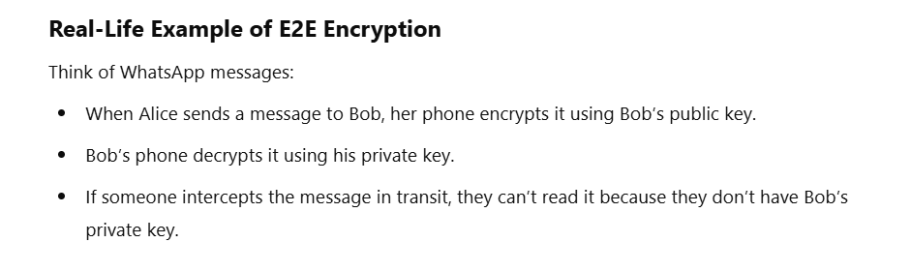
Key Distribution for End-to-End (E2E) Encryption

Slide 8
Key Management
Managing cryptographic keys is critical to ensure their confidentiality and integrity throughout their lifecycle. Key management involves generation, distribution, storage, rotation, and revocation.
Steps in Key Management
1. Key Generation
Explanation: Generate keys using secure and proven algorithms like AES for secret key cryptography or RSA for public key cryptography.
Example: A bank uses AES-256 to encrypt customer transaction data. The key is randomly generated to ensure unpredictability.
Notes:
Explanation: Key distribution ka matlab hai ke jo key generate hui hai, usay securely un logon tak pohanchana jin ko use karna hai. Yeh process is liye zaroori hai takay keys safe rahain aur koi unauthorized person un tak access na kar sake.
Real-Life Example in Roman Urdu: Sochiye aap ke ghar ka lock ka ek key hai. Aap chahte hain ke aapka dost us lock ko khol sake, lekin sirf aapka dost aur koi nahi. Agar aap wo key apne dost ko direct haath mein denge, to yeh ek secure method hai. Lekin agar aap key kisi aur ke through ya post se bhejen, to risk hai ke wo key galat haathon mein chali jaye.
Bank ka bhi same kaam hota hai. For example, ATM machine ko secure karne ke liye ek encryption key chahiye hoti hai. Bank yeh key ek secure network channel ke zariye ATM tak bhejta hai. Yeh channel fully encrypted hota hai, jisme kisi hacker ke liye key ko intercept karna mushkil hota hai.
Summary in Roman Urdu:
Key distribution ka maksad hai key ko ek safe tareeke se pohanchana. Jese aap apni ghar ki key sirf apne trustworthy dost ko dete hain, waise hi digital world mein secure channels ka use hota hai takay keys authorized log tak hi pohanch sakein.

Slide 9
Key Distribution Explanation
Key Distribution Explanation: Share the generated keys securely with the intended parties.
Example: Banks securely distribute encryption keys to ATMs via dedicated secure channels.
Key Storage Explanation: Store the keys securely to prevent unauthorized access.
Example: Use a Hardware Security Module (HSM) or encrypted databases to store keys.
Analogy: Just like you keep your house keys in a safe place, cryptographic keys must be stored securely.

Slide 10
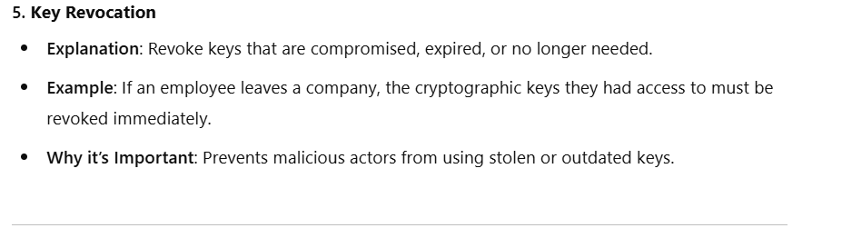
Key Rotation
Explanation: Periodically replace old keys with new ones to enhance security.
Example: Some systems change encryption keys every 24 hours or after a certain number of transactions.
Analogy: Think of regularly changing your door lock keys to ensure no one unauthorized has access.

Slide 11
Diffie-Hellman:key-exchange algo
The Diffie-Hellman Key Exchange algorithm, introduced by Whitfield Diffie and Martin Hellman in 1976, is one of the first methods for securely exchanging cryptographic keys over an insecure communication channel.
It revolutionized cryptography by allowing two parties to establish a shared secret key without having to physically meet or use a pre-shared key.
This concept paved the way for modern public key cryptography.
Theory and Easy Explanation
Purpose: The Diffie-Hellman algorithm is used for securely exchanging a shared secret key between two parties (e.g., Alice and Bob) over an insecure network like the internet. This shared key can then be used for symmetric encryption to securely communicate.

Slide 12
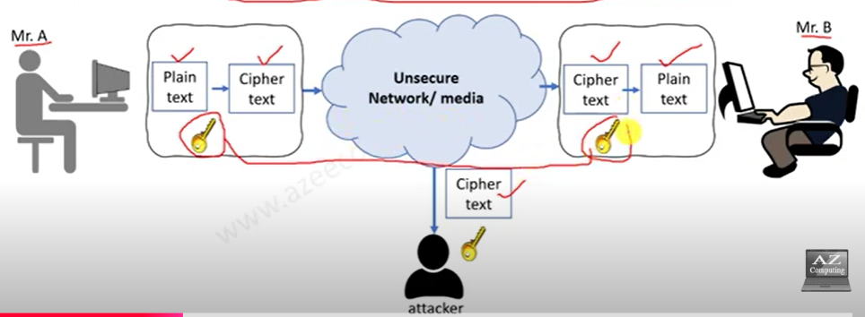
CONTI….
It is the method to exchange keys if we are using symmetric key approach
Same key is used for both encryption and decryption
Mr. A and Mr.b are communicating each other
Mr.A have a plaintext which he converted into cipher text
Means he did encryption of the text by using key
as we know that same key is used in symmetric key approach
By using some media cipher text is received by the Mr.b and he will use same key to convert that massage into plaintext

Slide 13
Cons of this approach
Let suppose the network which is used for communication have under attack as far as plaintext key the key which will used by Mr.B to decrypt the massage also travel through the same network medium
And it will easy for hacker to encrypt or decrypt that massage by using same share key
So this is the main disadvantage for this approach is key is also hacked
To mitigate this risk Diffie halman approach is used and the key will exchange by some method that it will difficult for hackers to guess the key

Slide 14
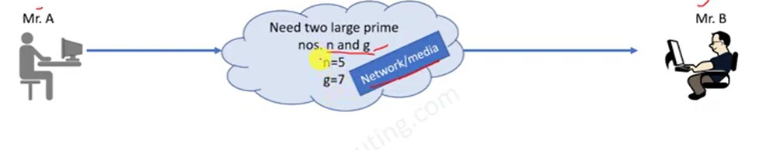
How we can use this algo
Mr A. wants to communicate Mr.B by using some network medium
In this algorithm we have to take 2 large prime numbers suppose one is
n and other is g ( the large prime numbers consider more secure )
n= 5 , g= 7 just for example
Prime number only divide on 1 and on it self
And these keys will share to Mr.A and Mr. b over the network
If attackers attacks on the network he wouldn’t know what will be the purpose of these values

Slide 15
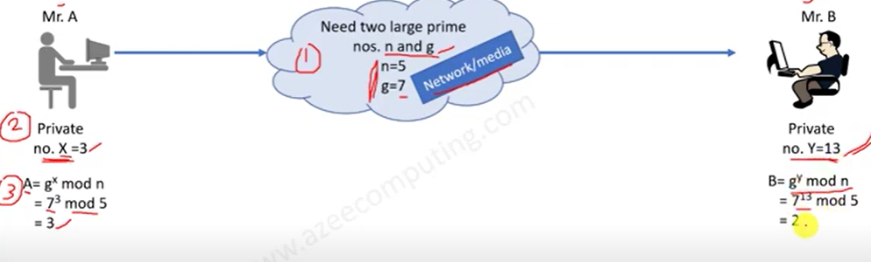
Step 2
Now Mr. A will define private number for it self which will X= 3
Same Mr. B define private number for his self which will be y = 13
And these numbers will remain private and it will never exchange with each others
Step 3
In this step we will calculate a value A and B
as for Mr. A formula is A = g^{x} modn
A = 7^³ mod5 = 3
For Mr. b formula is b B = g^{y} mod n
B = 7^¹³ mod5 = 2

Slide 16
STEP 4
Now A = 3 and B= 2 Now at this step value will be exchanged between Mr.A and Mr.B
Suppose if attackers is on the network he already knew the value of g and n so it will not possible for him to guess the values of A and B
If attacker also know that this communication is happened through Diffie halman and he knows the formula too but also in this case he can not guess the value of X and y on both side
Now after exchanging A and B values the values will be
For Mr.A B= 2
For Mr.B A= 3

Slide 17
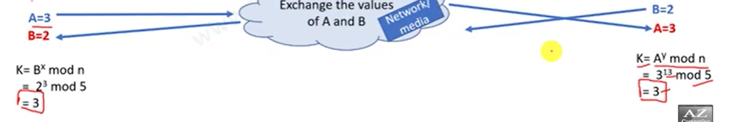
Step 5 Finding the value of key
The formula for finding the key is for Mr. A is
K = B^ ^{x} mod n
K= 2^³ mod 5 = 3
formula for finding the key for Mr. B is
K = A^ ^{y} mod n
K= 3^¹³ mod 5 = 3

Slide 18
Conti…..
So 3 will be our private key which will be used for both encryption and decryption
This is the main benefit of Diffie halman that if we don’t use this algorithm then attackers have easily take access of the keys and he will decrypt the plaintext
By using this algorithm hacker will never guess the original keys

